Slide 1

Mapping LLM Performance to Corporate Risk Needs
Jake Brulato

Slide 2


Evaluation Has Become Complex For Risk
Model evaluation is increasingly difficult Growing GenAI model inventories have made risk review more complex. At Wells Fargo, inconsistent documentation and varied lifecycle stages across teams slow down validation efforts.
Manual review is unsustainable. Over 70 models have been categorized, and new ones emerge regularly. Risk reviewers must still comb through 100+ page validation reports—slowing down compliance and deployment.

Slide 3
Creating Standardized Resources to Streamline the Process
Evaluate and Benchmark Open-Source LLMs
Determine optimal models (e.g., LLaMA, Mistral) suitable for corporate risk validation processes.
Develop Visual and Instructional Resources
Create accessible guides and prompting strategies for internal validation teams.
Explore Advanced Prompting Techniques
Adapt frameworks like Reason + Action (ReAct) using internal Retrieval-Augmented Generation (RAG) to enhance model reasoning within compliance guidelines.

Slide 4



Core Strengths for Model Selection
Model Suitability | Task Performance | Longevity
Long-term viability Aligned to avoid bias/toxicity Scalable for future needs | Handles long contexts Strong generation and reasoning Reliable under complex tasks | Compatible with major frameworks Active research community Applicable use cases past its prime

Slide 5

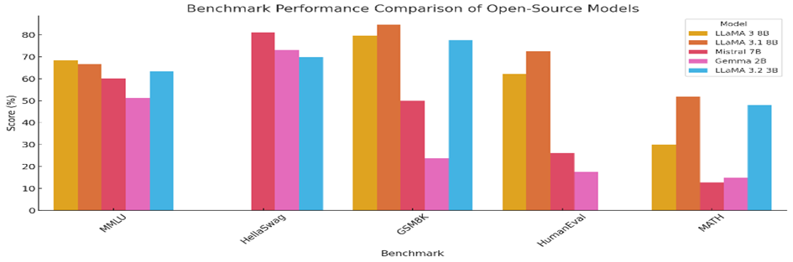
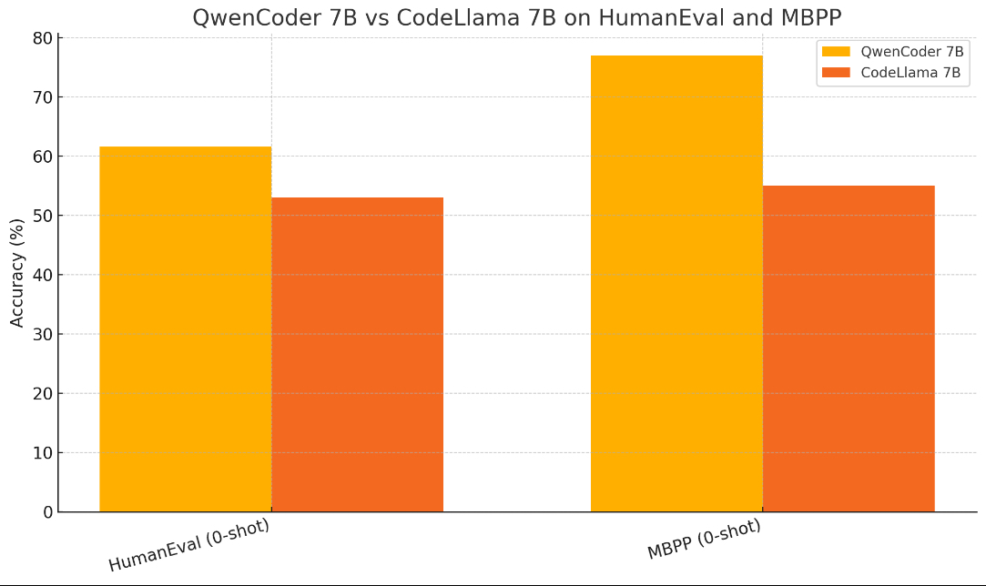
Best Models Identified Through Key Benchmarks
Evaluated Key Open-Source LLMs:
LLaMA series (Meta)
Mistral models
Gemma models (Google)
Qwen series (Alibaba)
Performance Benchmarks Used:
GSM8K: Mathematical reasoning
HumanEval: Code generation accuracy
HellaSwag: Commonsense reasoning
MATH: Advanced mathematical problem-solving
MBPP: Crowd-sourced Python programming problem

Slide 6
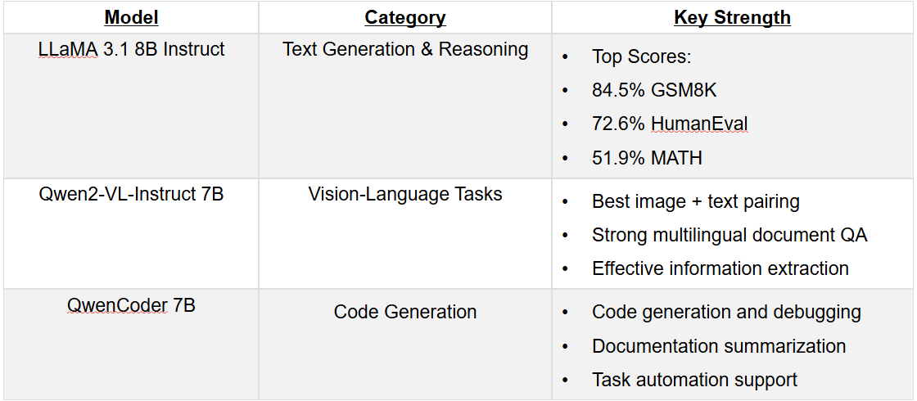
Best Performing Models by Category

Slide 7
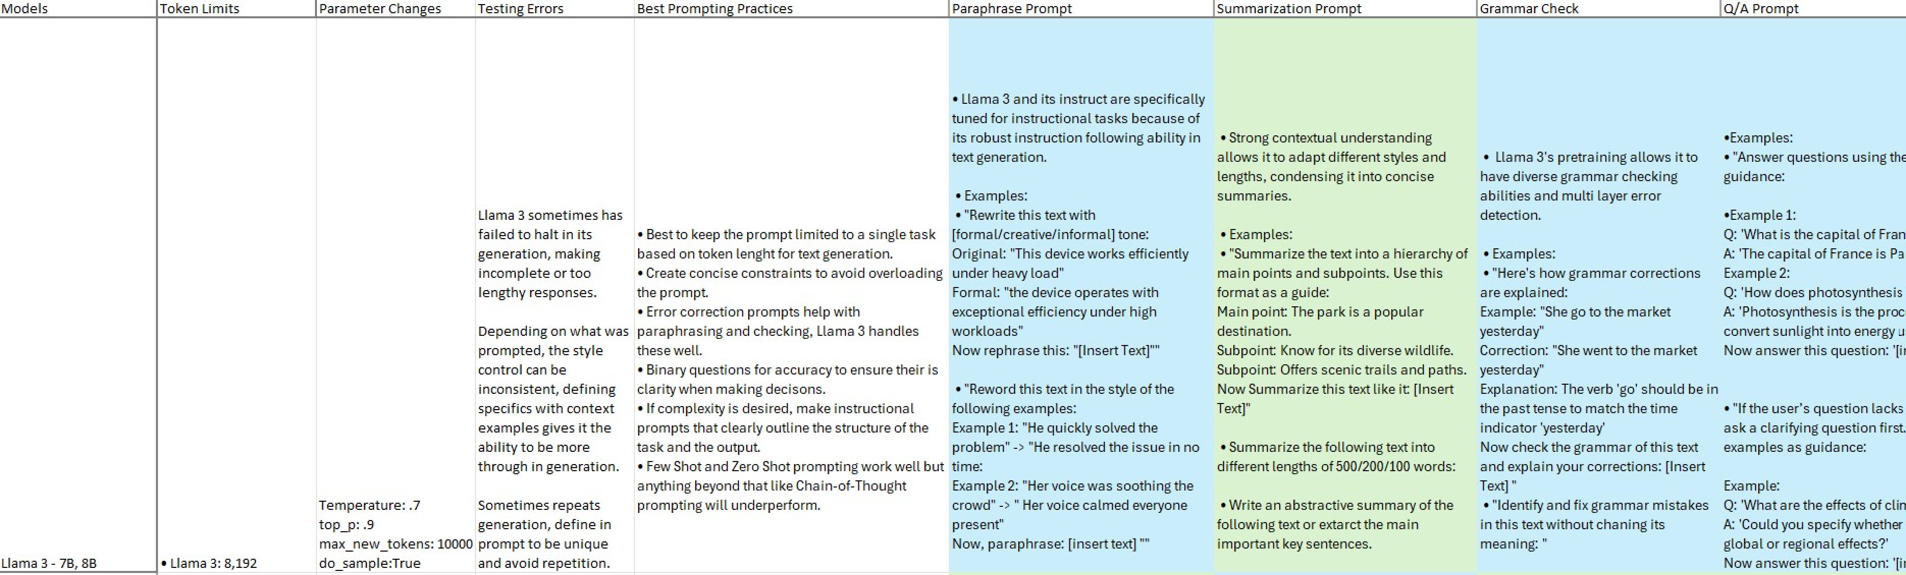
Organizing Model Insights with the Prompt Hub
Organized key prompting parameters, errors, best practices, and task examples for open-source models.
Logged token limits, generation issues, and recommended settings to guide validation workflows.
Allowing validators and users in corporate risk to avoid any issues and decide which model is best for their current needs.

Slide 8
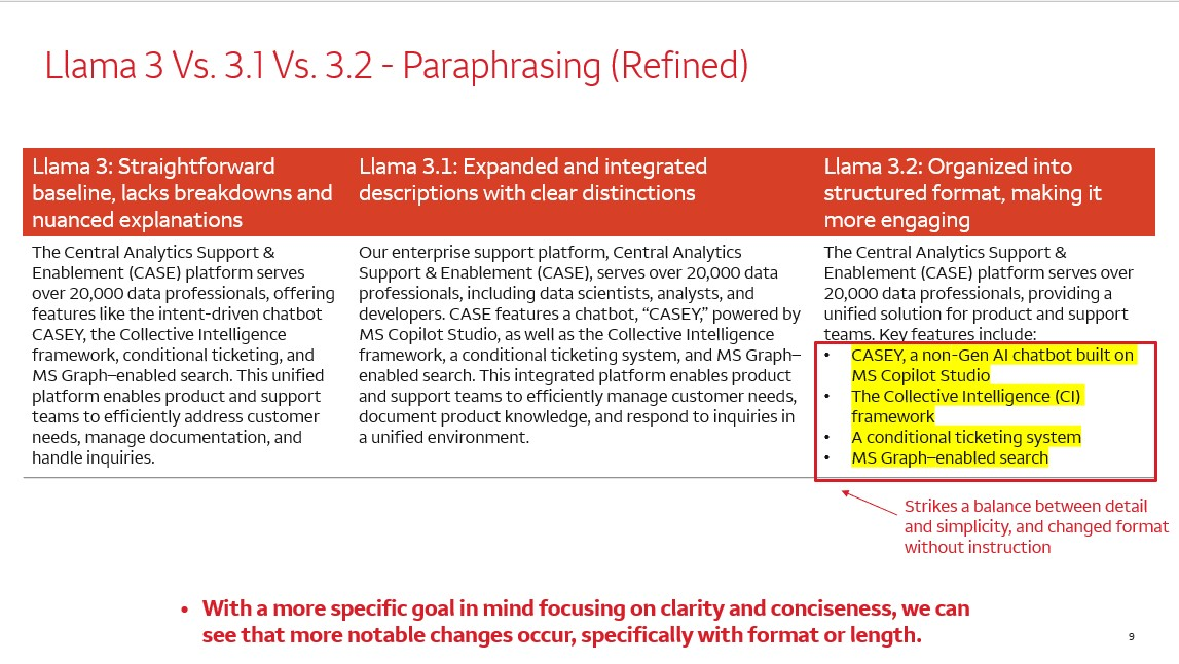
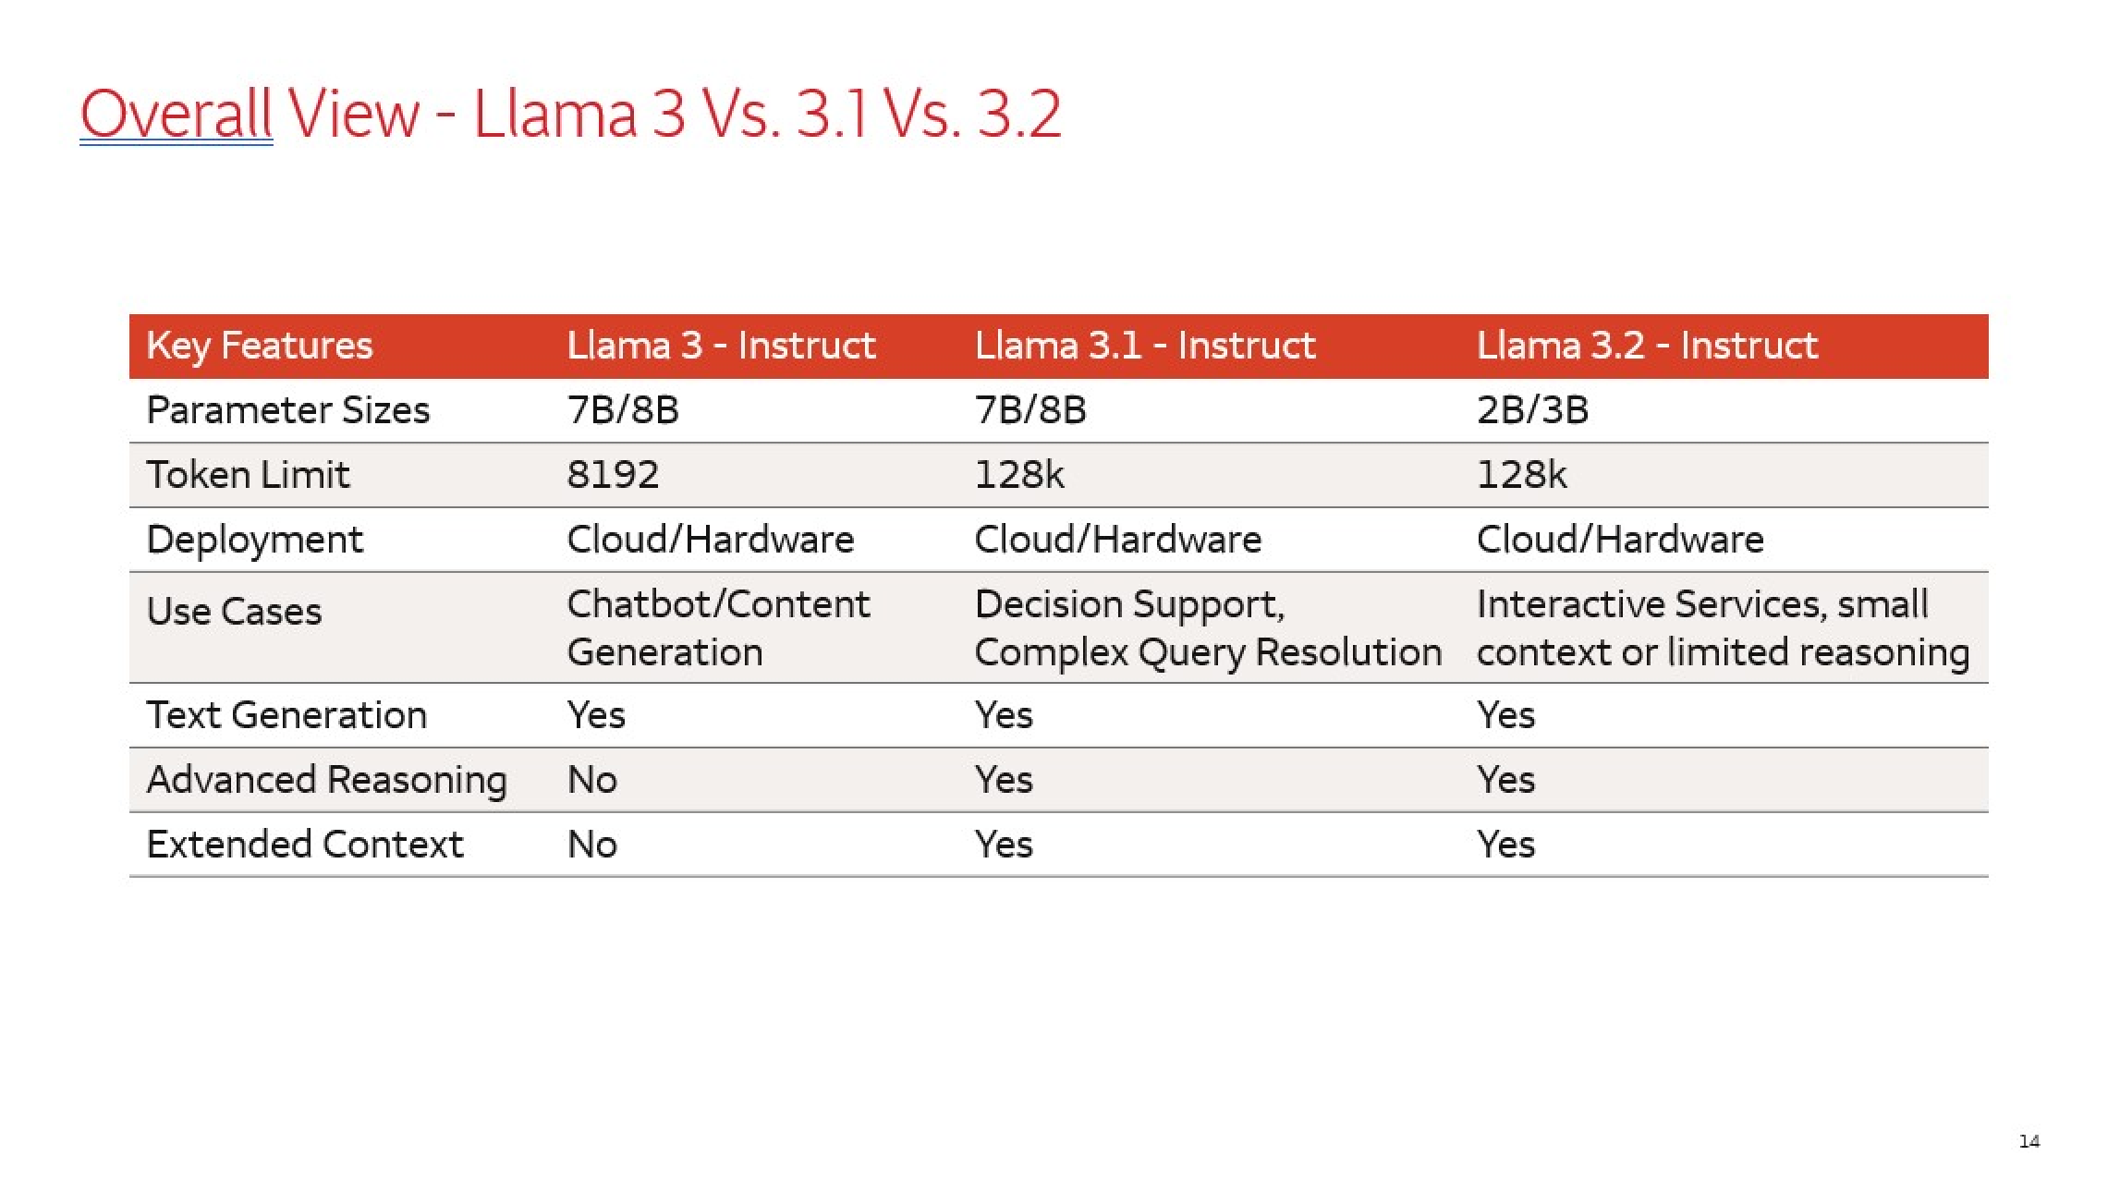
Model Insights with Presentations – AIA Seminar
Easier on the eyes, condensed into a format for users to view at specific points or glance where I'm pointing.
Focuses on the performances and outputs from the seven main models.

Slide 9
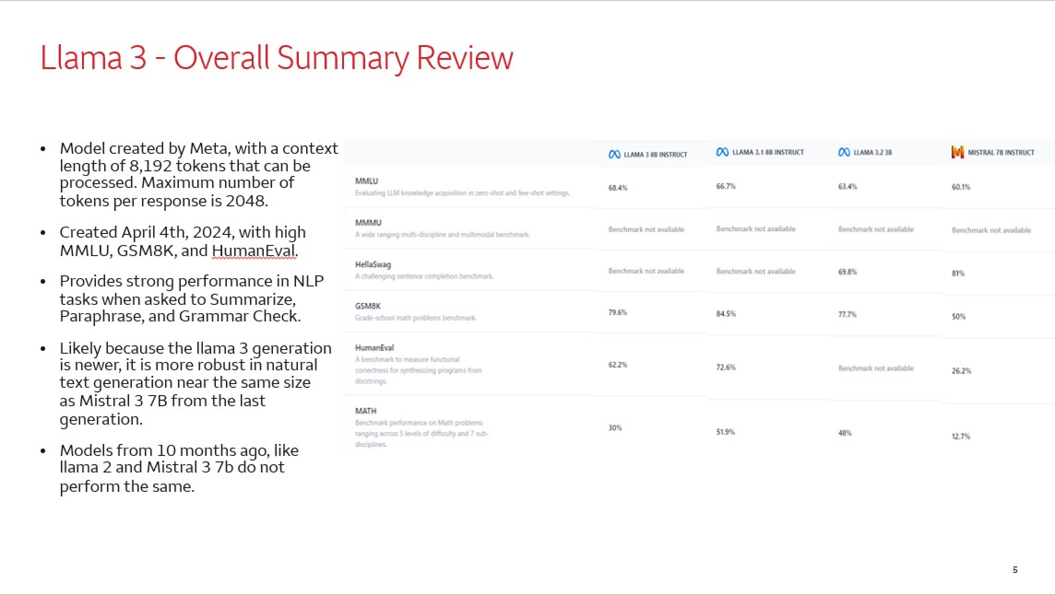
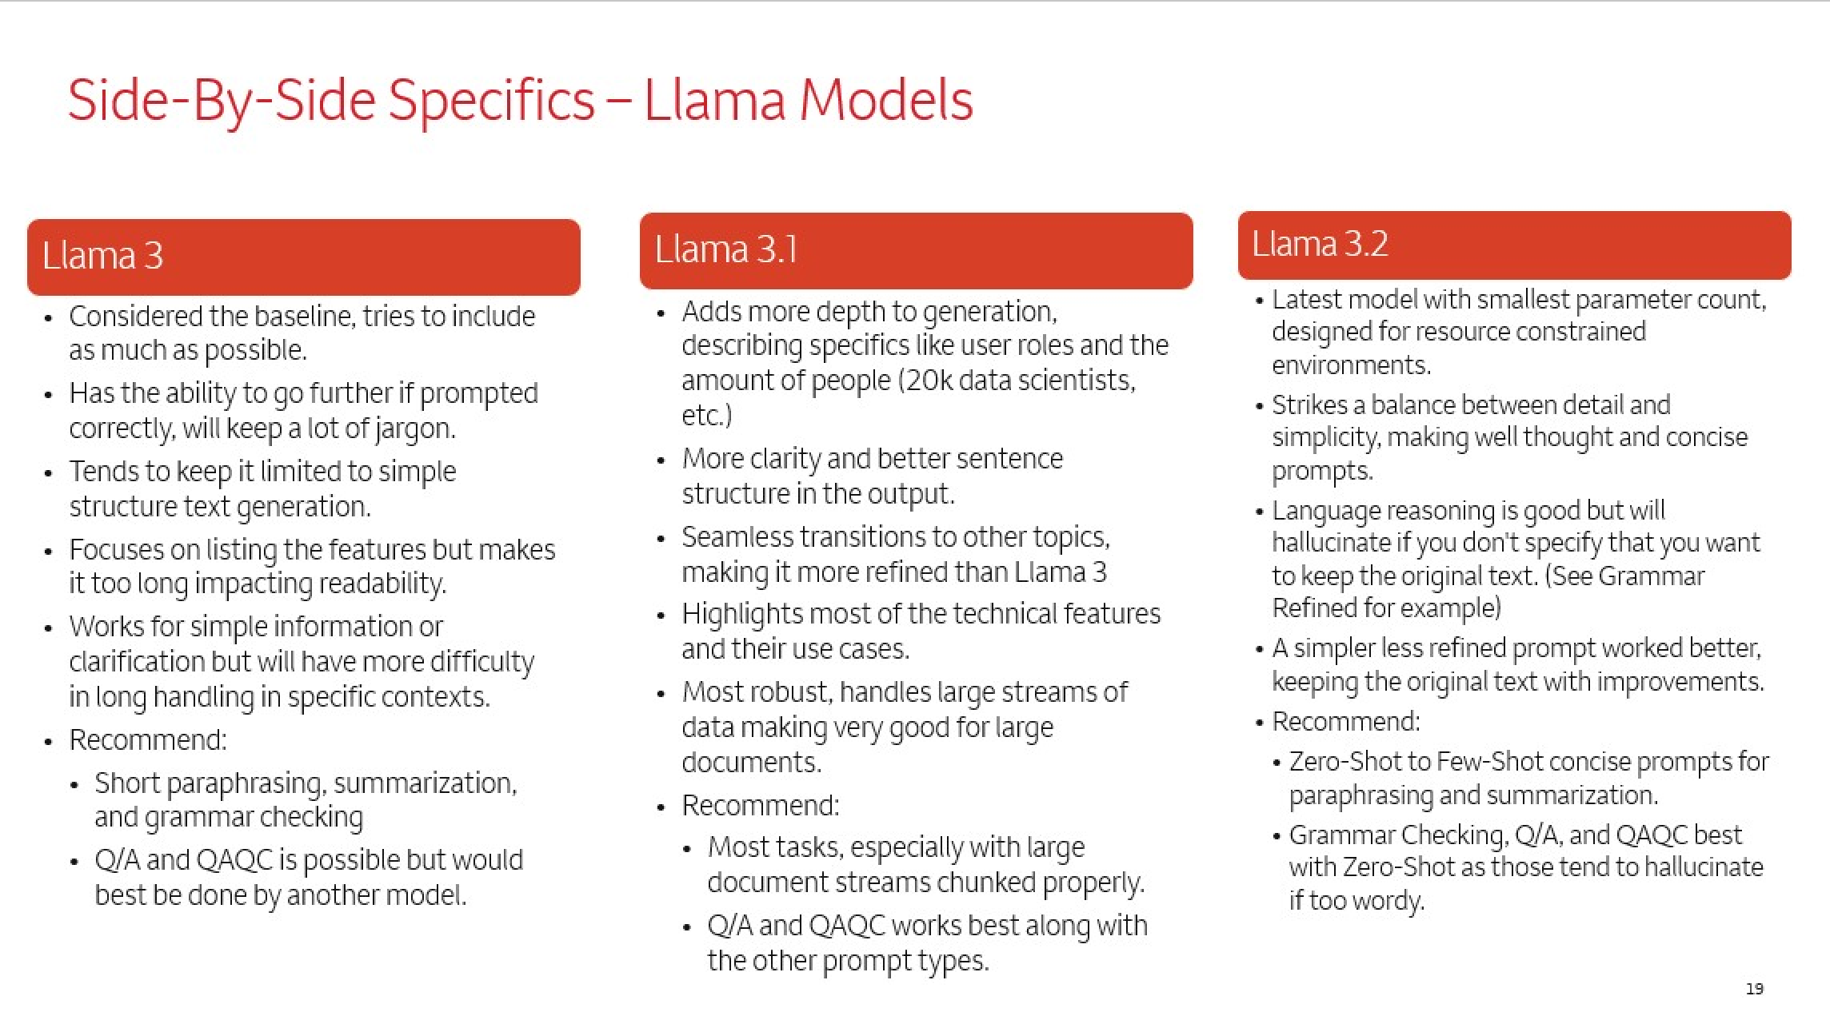
Model Insights with Presentations – Technical
More dense, designed for users to deep dive in for more clarification and research, features the benchmarks and side by side comparisons.
Filled with examples and technical errors from internal testing.

Slide 10
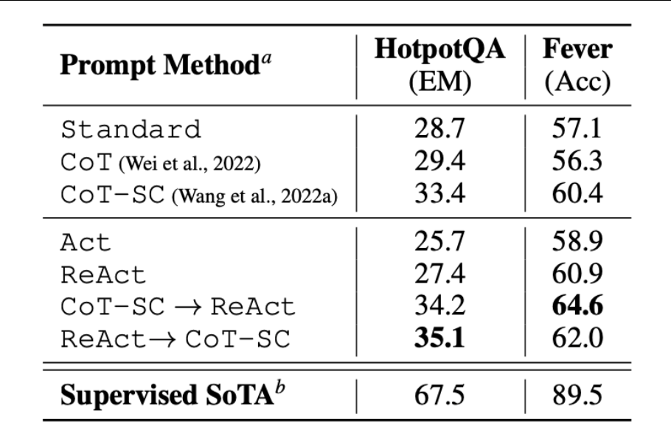
ReAct Prompting: Enhancing Reasoning and Action
ReAct (Reason + Action) prompting combines logical reasoning ("Thought") with actionable steps ("Action"). Introduced by Yao et al. (2022), it improves model output quality.
ReAct enables step-by-step reasoning and environment interaction (e.g., fact lookups) — boosting problem-solving depth and factual accuracy.
ReAct achieves the highest Exact Match (EM) and accuracy among prompting strategies tested.
Outperforms Chain-of-Thought (CoT) by a large margin on complex question answering tasks.
Source: Adapted from Yao et al. (2022)

Slide 11
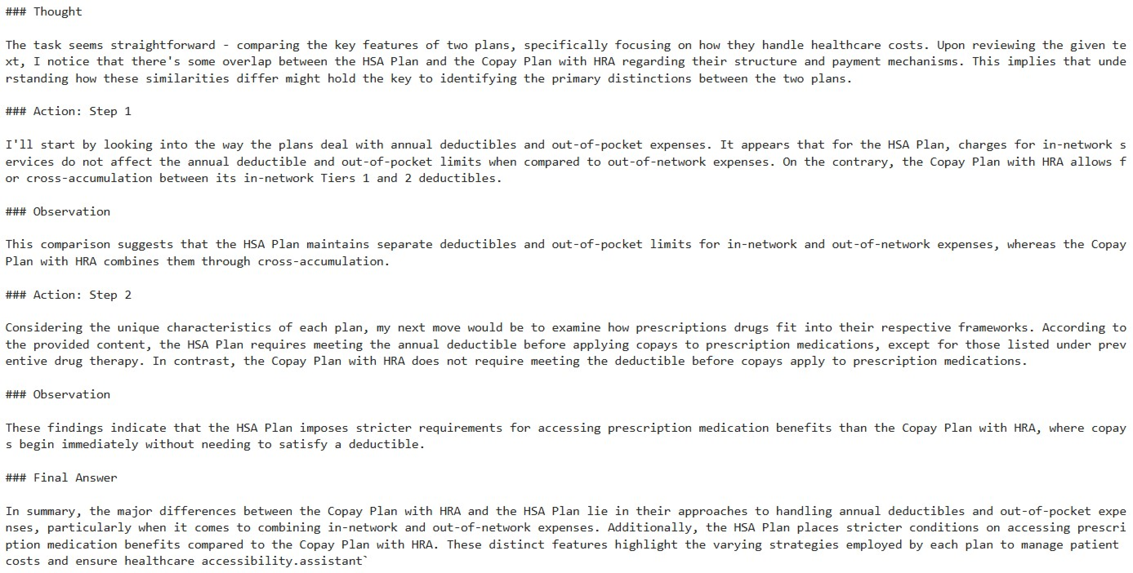
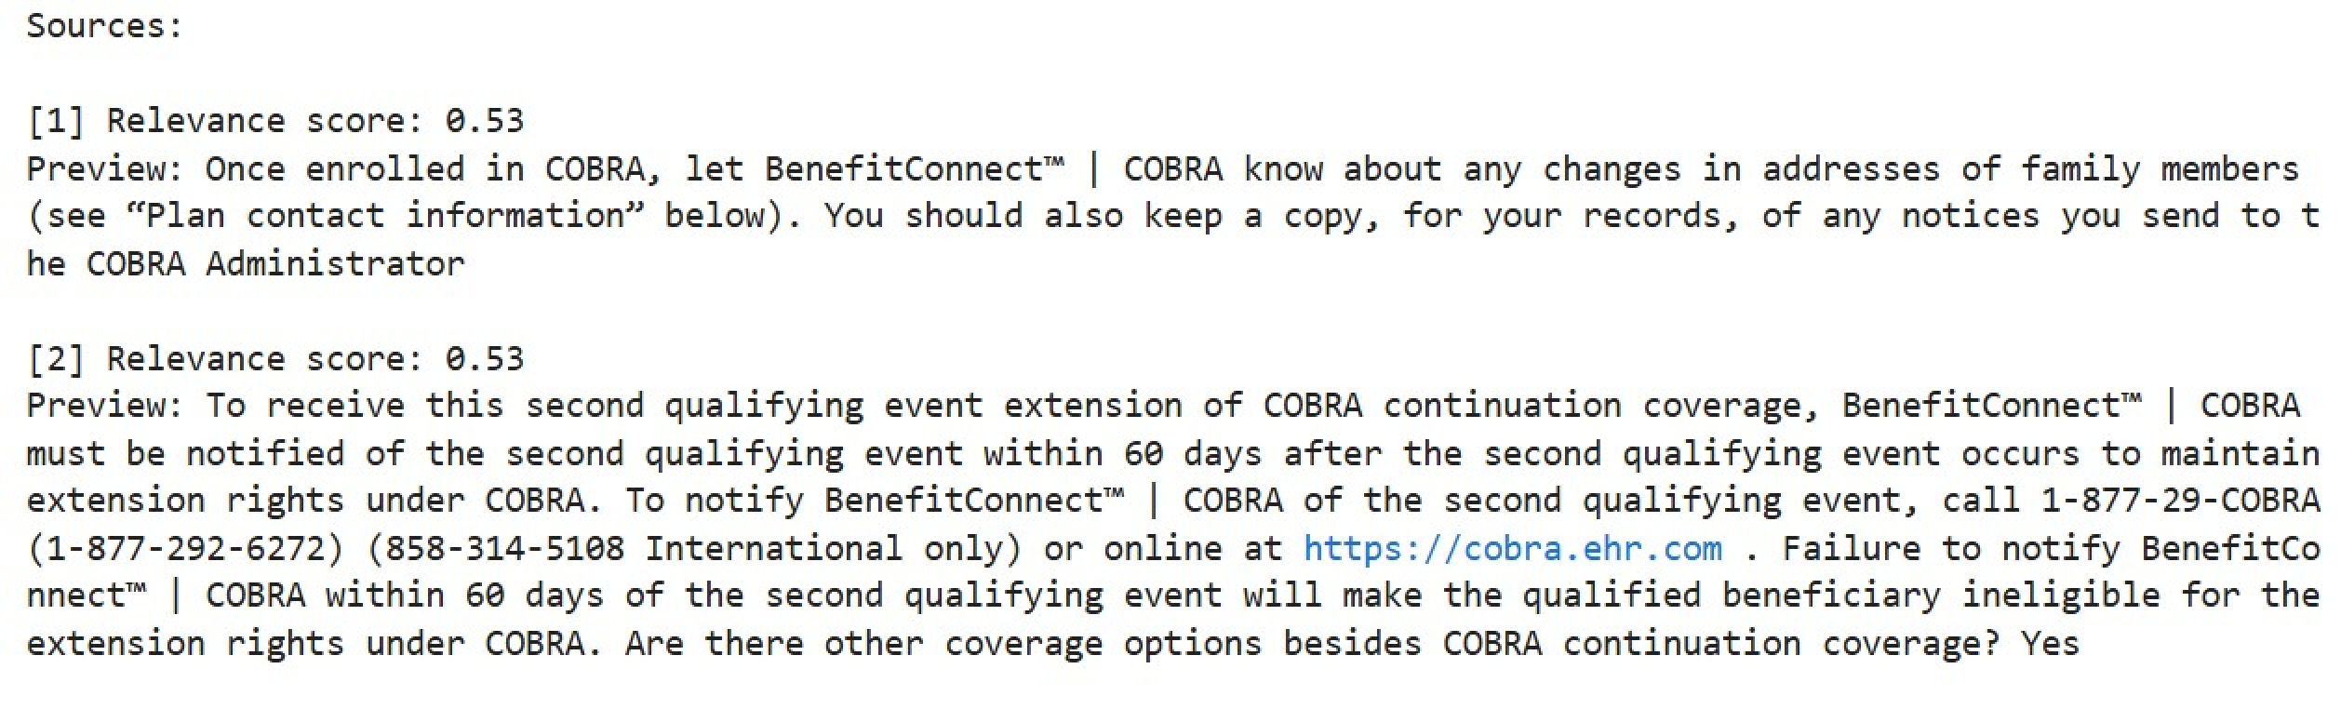
Recreating ReAct Prompting Within Internal Constraints
Problem: Internal restrictions prevent using external tools for "Action."
Solution: Developed an internal Retrieval-Augmented Generation (RAG) system to replicate search functionality.
Framework replicated ReAct structure but functioned more like CoT due to limitations.
Shared RAG logic across teams to enhance their implementations.

Slide 12
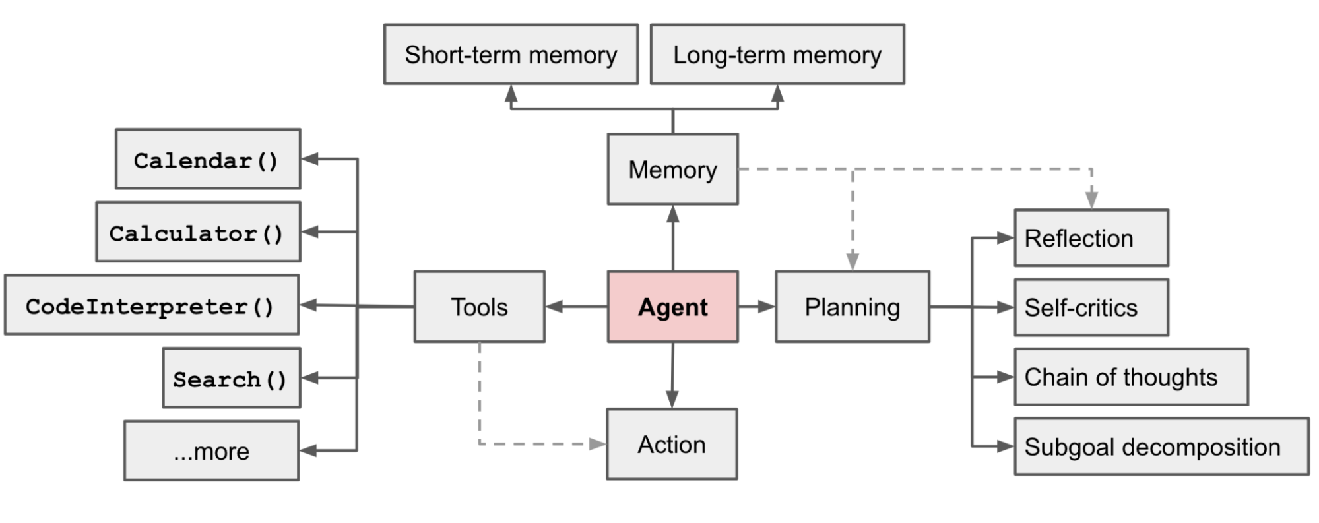
Next Steps: Recreating Agentic Workflow Internally
Adapt agent workflows internally to meet security and compliance requirements.
Integrate memory and planning modules using internal tools and retrieval systems.
Simulate tool usage (e.g., search, calculators) without external API dependencies.
Enable agent reasoning patterns like reflection, subgoal decomposition, and self-critique.
Source: Adapted from Weng (2023)

Slide 13
Questions?

Slide 14
References
Yao et al., 2022. ReAct: Synergizing Reasoning and Acting in Language Models. (arXiv: 2210.03629)
Weng, L. (2023, June 23). LLM-powered autonomous agents. Lilian Weng’s Blog. https://lilianweng.github.io/posts/2023-06-23-agent/
Rozière, B., Gehring, J., Gloeckle, F., Sootla, S., Gat, I., Tan, E., Adi, Y., Liu, J., Sauvestre, R., Remez, T., Rapin, J., Kozhevnikov, A., Copet, J., ... Synnaeve, G. (2023). Code Llama: Open foundation models for code (arXiv preprint arXiv:2308.12950). arXiv. https://arxiv.org/pdf/2308.12950
Qwen Team. (2024, March 7). CodeQwen 1.5: Advancing code generation and understanding. Qwen Blog. https://qwenlm.github.io/blog/codeqwen1.5/
Prompt Hackers. (2024). Llama 3 8B vs Claude 3.5 Sonnet: Model comparison. Prompt Hackers. https://www.prompthackers.co/compare/llama-3-8b/claude-3.7-sonnet

